Slide 1
Storing text in binary
Mack 2021

Slide 2
Storing text in binary
Computers store more than just numbers in binary. But how can binary numbers represent non-numbers such as letters and symbols?
As it turns out, all it requires is a bit of human cooperation. We must agree on encodings, mappings from a character to a binary number.

Slide 3
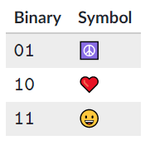
A simple encoding
For example, what if we wanted to store the following symbols in binary?
☮️❤️😀
We can invent this simple encoding:
Let's call it the HPE encoding. It helps for encodings to have names, so that programmers know they're using the same encoding.

Slide 4
A simple encoding
Let's call it the HPE encoding. It helps for encodings to have names, so that programmers know they're using the same encoding.
If a computer program needs to store the ❤️ symbol in computer memory, it can store 10 instead. When the program needs to display 10 to the user, it can remember the HPE encoding and display ❤️ instead.
Computer programs and files often need to store multiple characters, which they can do by stringing each character's encoding together.

Slide 5
A simple encoding
A program could write a file called "msg.hpe" with this data:
10111111010
A program on another computer that understands the HPE encoding can then open "msg.hpe" and display the sequence of symbols.

Slide 6

Check your Understanding
What sequence would the program display?
Notes:
🍐 This is a Pear Deck Multiple Choice Slide. Your current options are: A: ☮️❤️😀😀❤️☮️, B: ☮️☮️😀😀❤️❤️, C: ☮️😀❤️☮️😀❤️,
🍐 To edit the type of question or choices, go back to the "Ask Students a Question" in the Pear Deck sidebar.
B The HPE encoding only uses 2 bits, so that limits how many symbols it can represent.

Slide 7

Check your Understanding
How many symbols can the 2-bit encoding represent?
Notes:
🍐 This is a Pear Deck Text Slide
🍐 To edit the type of question, go back to the "Ask Students a Question" in the Pear Deck sidebar.
A binary number that is nnn bits long can represent 2^n2
n
2, start superscript, n, end superscript possible values, where the minimum value is 000 and the maximum value is 2^n - 12
n
−12, start superscript, n, end superscript, minus, 1.
In the case of n = 2n=2n, equals, 2, those two bits can represent 4 values: \texttt{0}\texttt{0}00start text, 0, end text, start text, 0, end text, \texttt{0}\texttt{1}01start text, 0, end text, start text, 1, end text, \texttt{10}10start text, 10, end text, and \texttt{11}11start text, 11, end text. We could add one more symbol to the HPE encoding, perhaps \texttt{0}\texttt{0}00start text, 0, end text, start text, 0, end text to represent 🌼.
However, with more bits of information, an encoding can represent enough letters for computers to store messages, documents, and webpages.

Slide 8
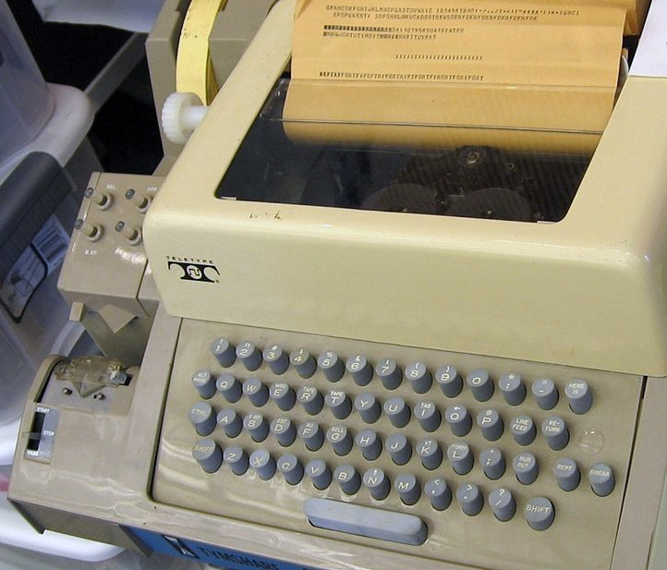
ASCII encoding
ASCII was one of the first standardized encodings. It was invented back in the 1960s when telegraphy was the primary form of long-distance communication, but is still in use today on modern computing systems.
Teletypists would type messages on teleprinters such as this one:

Slide 9
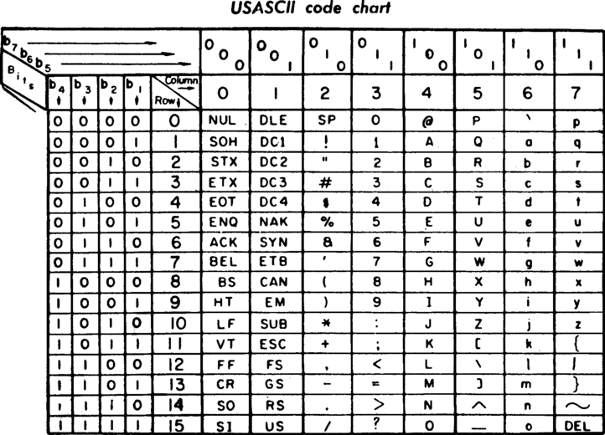
ASCII encoding
The teleprinter would then use the ASCII standard to encode each typed character into binary and then store or transmit the binary data.
This page from a 1972 teleprinter manual shows the 128 ASCII codes:

Slide 10
ASCII encoding
Each ASCII character is encoded in binary using 7 bits. In the chart above, the column heading indicates the first 3 bits and the row heading indicates the final 4 bits. The very first character is "NUL", encoded as 0000000s.
The first 32 codes represent "control characters," characters which cause some effect besides printing a letter. "BEL" (encoded in binary as 0000111) caused an audible bell or beep. "ENQ" (encoded as 0000101) represented an enquiry, a request for the receiving station to identify themselves.

Slide 11
ASCII encoding
The control characters were originally designed for teleprinters and telegraphy, but many have been re-purposed for modern computers and the Internet—especially "CR" and "LF". "CR" (0001101) represented a "carriage return" on teleprinters, moving the printing head to the start of the line. "LF" (0001010) represented a "line feed", moving the printing head down one line. Modern Internet protocols, such as HTTP, FTP, and SMTP, use a combination of "CR" + "LF" to represent the end of lines.
The remaining 96 ASCII characters look much more familiar.

Slide 12
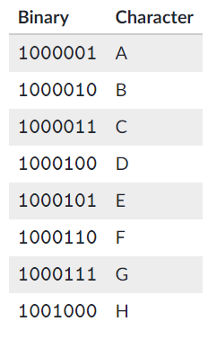
ASCII encoding
Here are the first 8 uppercase letters:

Slide 13

Check your Understanding
Following the ASCII standard, we can encode a four-letter message into binary:
1000011 1001000 1000101 1000110
What word does that ASCII-encoded binary data represent?
Notes:
🍐 This is a Pear Deck Multiple Choice Slide. Your current options are: A: FADE, B: CAFE, C: CHEF, D: BEAD,
🍐 To edit the type of question or choices, go back to the "Ask Students a Question" in the Pear Deck sidebar.
C

Slide 14
ASCII
There are several problems with the ASCII encoding, however.
The first big problem is that ASCII only includes letters from the English alphabet and a limited set of symbols.
A language that uses less than 128 characters could come up with their own version of ASCII to encode text in just their language, but what about a text file with characters from multiple languages? ASCII couldn't encode a string like: "Hello, José, would you care for Glühwein? It costs 10 €".

Slide 15
ASCII
And what about languages with thousands of logograms? ASCII could not encode enough logograms to cover a Chinese sentence like "你好，想要一盘饺子吗？十块钱。"
The other problem with the ASCII encoding is that it uses 7 bits to represent each character, whereas computers typically store information in bytes—units of 8 bits—and programmers don't like to waste memory.

Slide 16
ASCII
When the earliest computers first started using ASCII to encode characters, different computers would come up with various ways to utilize the final bit. For example, HP computers used the eighth bit to represent characters used in European countries (e.g. "£" and "Ü"), TRS-80 computers used the bit for colored graphics, and Atari computers used the bit for inverted white-on-black versions of the first 128 characters.
The result? An "ASCII" file created in one application might look like gobbledy gook when opened in another "ASCII"-compatible application.
Computers needed a new encoding, an encoding based on 8-bit bytes that could represent all the languages of the world.

Slide 17
Unicode
But first, how many characters do you even need to represent the world's languages? Which characters are basically the same across languages, even if they have different sounds?
In 1987, a group of computer engineers attempted to answer those questions. They eventually came up with Unicode, a universal character set which assigns each a "code point" (a hexadecimal number) and a name to each character.

Slide 18
Unicode
For example, the character "ą" is assigned to "U+0105" and named "Latin Small Letter A with Ogonek". There's a character that looks like "ą" in 13 languages, such as Polish and Lithuanian. Thus, according to Unicode, the "ą" in the Polish word "robią" and the "ą" in the Lithuanian word "aslą" are both the same character. Unicode saves space by unifying characters across languages.
But there are still quite a few characters to encode. The Unicode character set started with 7,129 named characters in 1991 and has grown to 137,929 named characters in 2019. The majority of those characters describe logograms from Chinese, Japanese, and Korean, such as "U+6728" which refers to "木". It also includes over 1,200 emoji symbols ("U+1F389" = "🎉").
Unicode is a character set, but it is not an encoding. Fortunately, another group of engineers tackled the problem of efficiently encoding Unicode into binary.

Slide 19
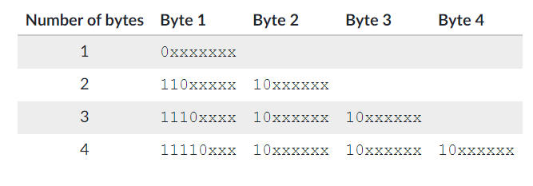
UTF-8
In 1992, computer scientists invented UTF-8, an encoding that is compatible with ASCII encoding but also solves its problems.
UTF-8 can describe every character from the Unicode standard using either 1, 2, 3, or 4 bytes.
When a computer program is reading a UTF-8 text file, it knows how many bytes represent the next character based on how many 1 bits it finds at the beginning of the byte.

Slide 20
UTF-8
If there are no 1 bits in the prefix (if the first bit is a 0), that indicates a character represented by a single byte. The remaining 7 bits of the byte are used to represent the original 128 ASCII characters. That means a sequence of 8-bit ASCII characters is also a valid UTF-8 sequence.
Two bytes beginning with 110 are used to encode the rest of the characters from Latin-script languages (e.g. Spanish, German) plus other languages such as Greek, Hebrew, and Arabic. Three bytes starting with 1110 encode most of the characters for Asian languages (e.g. Chinese, Japanese, Korean). Four bytes starting with 11110 encode everything else, from rarely used historical scripts to the increasingly commonly used emoji symbols.

Slide 21
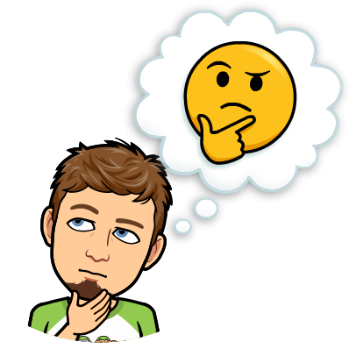
Check your Understanding
According to the UTF-8 standard, how many characters are represented by these 8 bytes? 01001001 11110000 10011111 10010010 10011001 11100010 10010011 10001010
Notes:
🍐 This is a Pear Deck Text Slide
🍐 To edit the type of question, go back to the "Ask Students a Question" in the Pear Deck sidebar.
The first byte is \texttt{0}\texttt{10}\texttt{0}\texttt{10}\texttt{0}\texttt{1}01001001start text, 0, end text, start text, 10, end text, start text, 0, end text, start text, 10, end text, start text, 0, end text, start text, 1, end text. That starts with a \texttt{0}0start text, 0, end text, so we know this single byte represents a character. We don't need to actually determine which character; we just need to understand that the first byte represents one character.
The next byte is \texttt{11110}\texttt{0}\texttt{0}\texttt{0}11110000start text, 11110, end text, start text, 0, end text, start text, 0, end text, start text, 0, end text. That starts with four \texttt{1}1start text, 1, end text bits, which means this byte is the start of 4-byte sequence representing a character:
\texttt{11110}\texttt{0}\texttt{0}\texttt{0}\,\texttt{10}\texttt{0}\texttt{11111}\,\texttt{10}\texttt{0}\texttt{10}\texttt{0}\texttt{10}\,\texttt{10}\texttt{0}\texttt{110}\texttt{0}\texttt{1}11110000100111111001001010011001start text, 11110, end text, start text, 0, end text, start text, 0, end text, start text, 0, end text, start text, 10, end text, start text, 0, end text, start text, 11111, end text, start text, 10, end text, start text, 0, end text, start text, 10, end text, start text, 0, end text, start text, 10, end text, start text, 10, end text, start text, 0, end text, start text, 110, end text, start text, 0, end text, start text, 1, end text
The sixth byte is \texttt{1110}\texttt{0}\texttt{0}\texttt{10}11100010start text, 1110, end text, start text, 0, end text, start text, 0, end text, start text, 10, end text. That starts with three 1 bits, so this byte is the start of a 3-byte sequence:
\texttt{1110}\texttt{0}\texttt{0}\texttt{10}\,\texttt{10}\texttt{0}\texttt{10}\texttt{0}\texttt{11}\,\texttt{10}\texttt{0}\texttt{0}\texttt{1010}111000101001001110001010start text, 1110, end text, start text, 0, end text, start text, 0, end text, start text, 10, end text, start text, 10, end text, start text, 0, end text, start text, 10, end text, start text, 0, end text, start text, 11, end text, start text, 10, end text, start text, 0, end text, start text, 0, end text, start text, 1010, end text
Thus, in UTF-8, the 8 bytes represent 3 characters.

Slide 22
UTF-8
Most modern programming languages have built-in support for UTF-8, so most programmers never need to know exactly how to convert from characters to binary.
✏️ Try out using JavaScript to encode strings in UTF-8 in the form below. Play around with multiple languages and symbols.

Slide 23
UTF-8
The UTF-8 encoding standard is now the dominant encoding of HTML files on the web, accounting for 94.5% of webpages as of December 2019.
Generally, a good encoding is one that can represent the maximum amount of information with the least number of bits. UTF-8 is a great example of that, since it can encode common English letters with just 1 byte but is flexible enough to encode thousands of letters with additional bytes.
UTF-8 is only one possible encoding, however. UTF-16 and UTF-32 are alternative encodings that are also capable of representing all Unicode characters. There are also language specific encodings such as Shift-JIS for Japanese. Computer programs can use the encoding that best suits their needs and constraints.

Slide 24


Slide 25
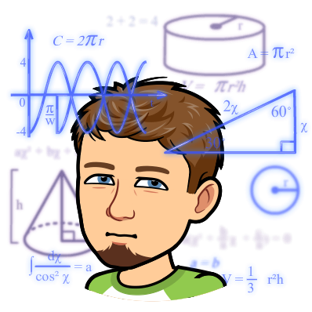
Practice

Slide 26
Which types of data are stored on a computer using bits?
Numbers
Text documents
Photos
Choose 1 answer:
Notes:
🍐 This is a Pear Deck Multiple Choice Slide. Your current options are: A: I only, B: I and II only, C: I and III only, D: All,
🍐 To edit the type of question or choices, go back to the "Ask Students a Question" in the Pear Deck sidebar.
D

Slide 27

TSCII is a character encoding scheme that can encode text written in the Tamil language. TSCII uses one byte to encode each character.
This binary data is a TSCII encoding of a single Tamil word:
How many characters are encoded in that binary data?
Choose 1 answer:
Notes:
🍐 This is a Pear Deck Multiple Choice Slide. Your current options are: A: 2, B: 4, C: 32, D: 8,
🍐 To edit the type of question or choices, go back to the "Ask Students a Question" in the Pear Deck sidebar.
B

Slide 28
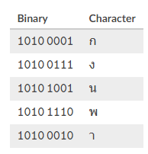
TIS-620 is a character encoding that can encode Thai text files. The encoding is based on the ASCII standard but includes mappings for the letters of the Thai alphabet.
This table shows the mapping for five of the letters:
According to TIS-620 , what is the binary encoding of the Thai word "พนา?
Note that the Thai language is written from left to right, like the English language.
Choose 1 answer:
Notes:
🍐 This is a Pear Deck Multiple Choice Slide. Your current options are: A: 1011 1011 1101, B: 1010 0111 1101 0010 1010 0001, C: 1110 1001 0010, D: 1010 1110 1010 1001 1010 0010,
🍐 To edit the type of question or choices, go back to the "Ask Students a Question" in the Pear Deck sidebar.
D

Slide 29
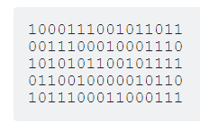
Consider this sequence of bits:
What is true about this binary data?
Choose 1 answer:
Notes:
🍐 This is a Pear Deck Multiple Choice Slide. Your current options are: A: This sequence of bits might represent positive and negative numbers, but it could not represent any fractional numbers, B: This sequence of bits might represent positive, negative, or fractional numbers, C: This sequence of bits might represent positive numbers and fractional numbers, but it could not represent any negative numbers, D: This sequence of bits might represent positive numbers, but it could not represent any negative or fractional numbers,
🍐 To edit the type of question or choices, go back to the "Ask Students a Question" in the Pear Deck sidebar.
B

